Slide 1
Computer Hardware
Pseudocode and Flowchart to find greatest of 3 nos
By Hasna Haseeb K C

Slide 2
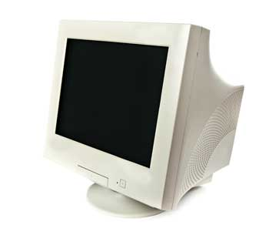
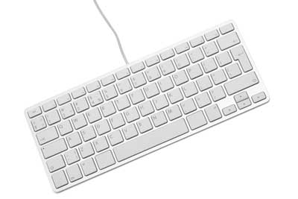
Computer Hardware
Represents the physical and tangible components of a computer
Components that can be seen or touched
It includes :
  Input Unit
  Output Unit
  Memory Unit
  ALU
  CPU
  Secondary Storage

Slide 3
Input Unit
The input unit is formed by the input devices attached to the computer
Responsible for taking input and converting it into computer understandable form (the binary code)
It includes Keyboard, Mouse etc

Slide 4
Output Unit
After processing of data, it is converted into a format which humans can understand.
Output units displays this data to users
It include monitors, printers and speakers

Slide 5
Memory Unit
Used to store data, instructions and information
There are two types of memory:
  Read-only memory (ROM):- ROM is a part of the memory unit. This is read only memory, and it can not be used to write.
  Random-access memory (RAM):- RAM is also part of the memory unit, and it is used for the temporary storage of program data.

Slide 6
ALU
Arithmetic and Logic Unit
ALU is a major component of the central processing unit of the computer system
It does all processes related to arithmetic and logic operations that needs to be done

Slide 7
CPU
Central Processing Unit
CPU is considered as the brain of the computer
Performs all types of data processing operations
It stores data, intermediate results, and instructions
Controls the operation of all parts of the computer

Slide 8
Secondary Storage
It is non-volatile, it retains data even when power is switched off
It is cheaper as compared to primary memory
Secondary storage devices like CDs and flash drives can transfer the data from one device to another

Slide 9
Find the greatest of 3 numbers
Pseudocode:
  Input three numbers, n1 n2 n3
  If n1>n2, check if n1>n3
    Set max=n1 else set max=n3
  Else check n2>n3
    Set max=n2 else set max=n3
  Print max

Slide 10
Flowchart
Start
Input n1, n2, n3
max= (n1>n2) ? (n1>n3) ? n1 : n3
: (n2>n3) ? n2 : n3
Print max
Stop

Slide 11
Thank You

